Slide 1

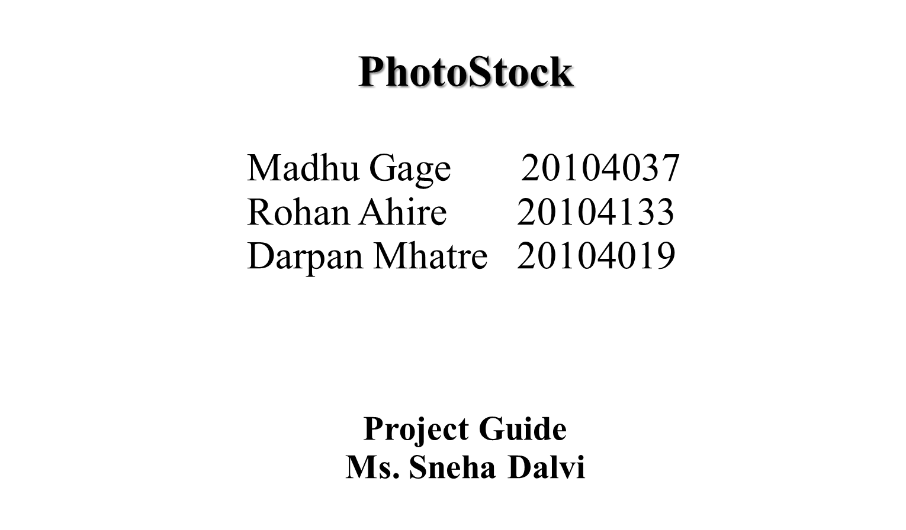

Slide 2
Contents
Introduction
Objectives
Scope
Literature Survey
Proposed System
Project Outcomes
Features
Technology Stack
Future Scope
Flow Chart
Data Flow Diagram
Reference

Slide 3




1. Introduction
Problem Identified :
    Copyright issue.
    Time consuming.
    Less choices.
Solution Proposed :
    Licensed and plagiarism free photographs.
    Quality images on finger tips.
    Wide range of options.

Slide 4
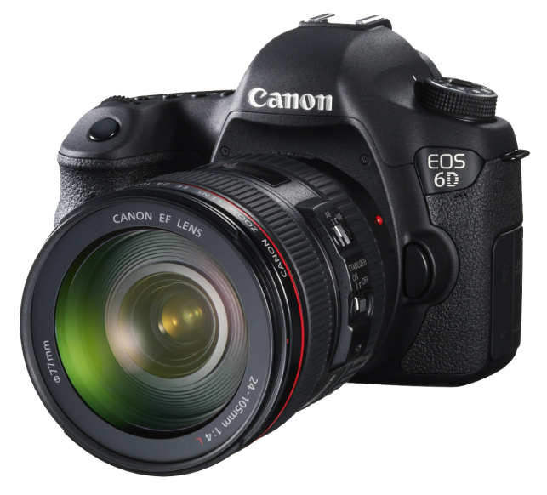

2. Objectives
Our main objective is to provide:
Wide range of choice.
Clear licencing Agreement.
High Quality of Images.
Platform for the photographers and content creators.

Slide 5


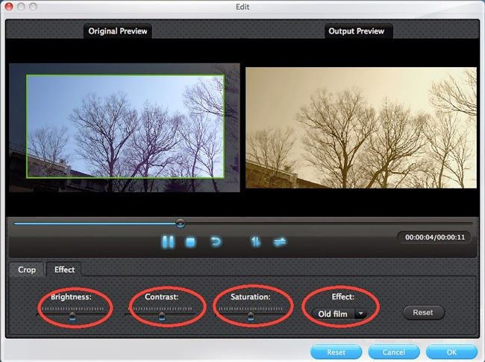
3. Scope
Our website can be used
To acquire images of a high caliber.
To use photography as passive income source.
To obtain free stock photography.
To alter or edit any picture.

Slide 6
5. Proposed System
Elegant and Simple design
  Home page with search, login/logout, upload, edit page.
Divided into sections
  Contents are divided into various section.
  The user can look up any image they wish.
Easy and safe payment
  Safe transaction with UPI or card payment.
Review and Feedback
  User can contact us and share their feedback or queries.

Slide 7
6. Outcome of Project
User can go through alternatives.
User can use the images without worrying about copyright infringement.
Provide photographers a platform.
Give photographers a means to make money.

Slide 8
4. Literature Survey
Year | Author | Title | Outcome
2019 | R.M.K. Engineering college, Tamil Nadu | Online Studio Management System | Support to photography and videography enterprise Physical photography or videography services can be booked according to the availability of dates Customized products can be ordered online
2022 | Eric T. Meyer | Digital Photography | Digital photography is the process of using electronic and computing appliances to capture, create, edit and share digital images. It encompasses several different technologies to provide electronic or computer-based photography services.
2018 | Dr. R. Karuppasamy and Mr. C. Arul Venkadesh | Information Technology and Communication in Business | ICT is used to enhance one’s business. Defined as the application of information and communication technologies (ICT) in support of all the activities of business.

Slide 9
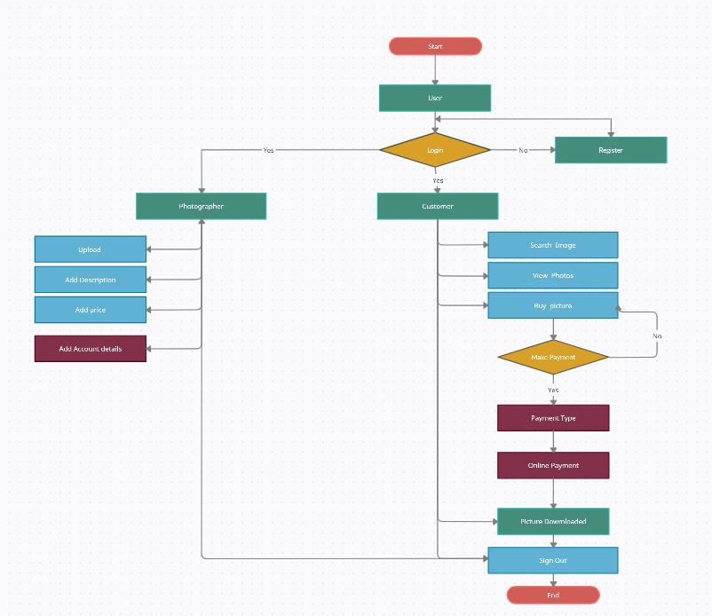
7. Flow Chart

Slide 10
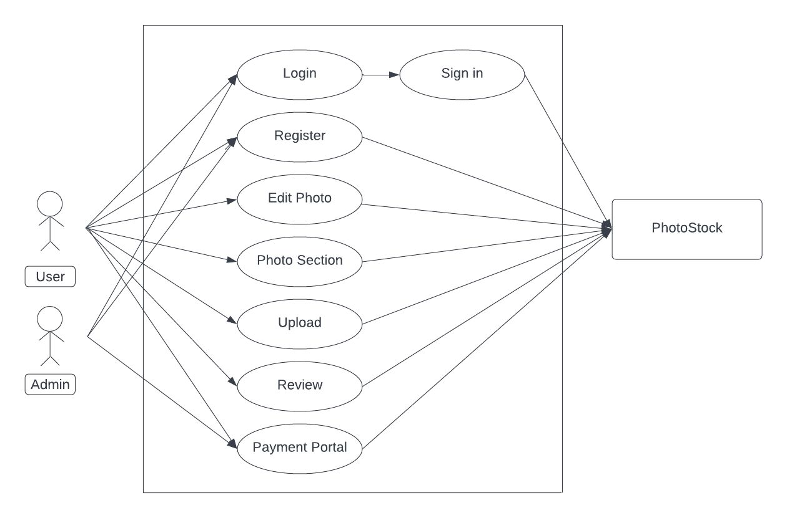
8. Use Case Diagram

Slide 11
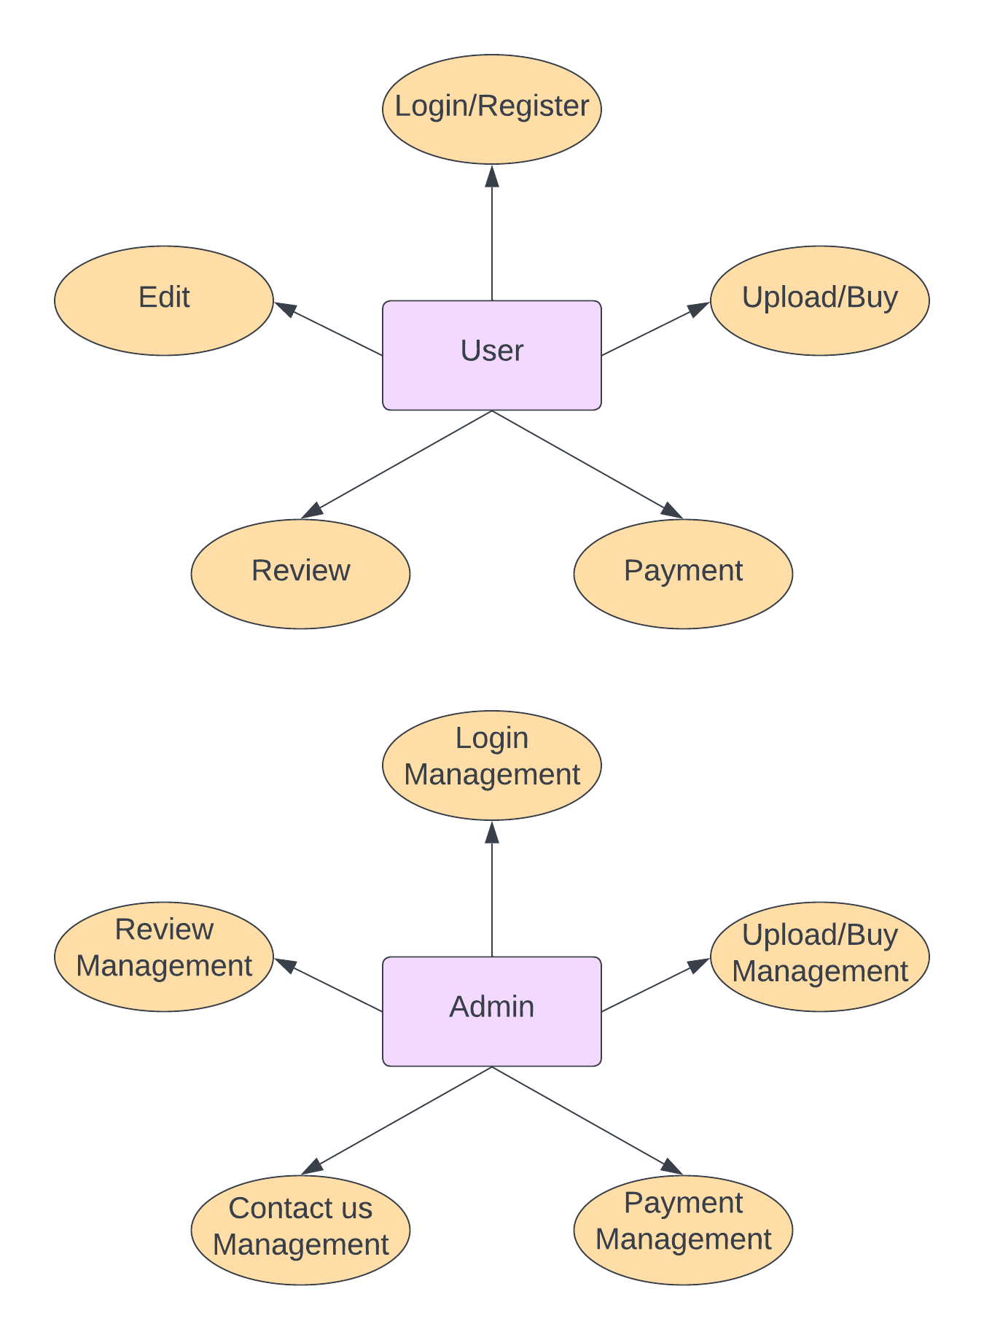
Data flow Diagram
Fig.8.1 DFD level 0

Slide 12
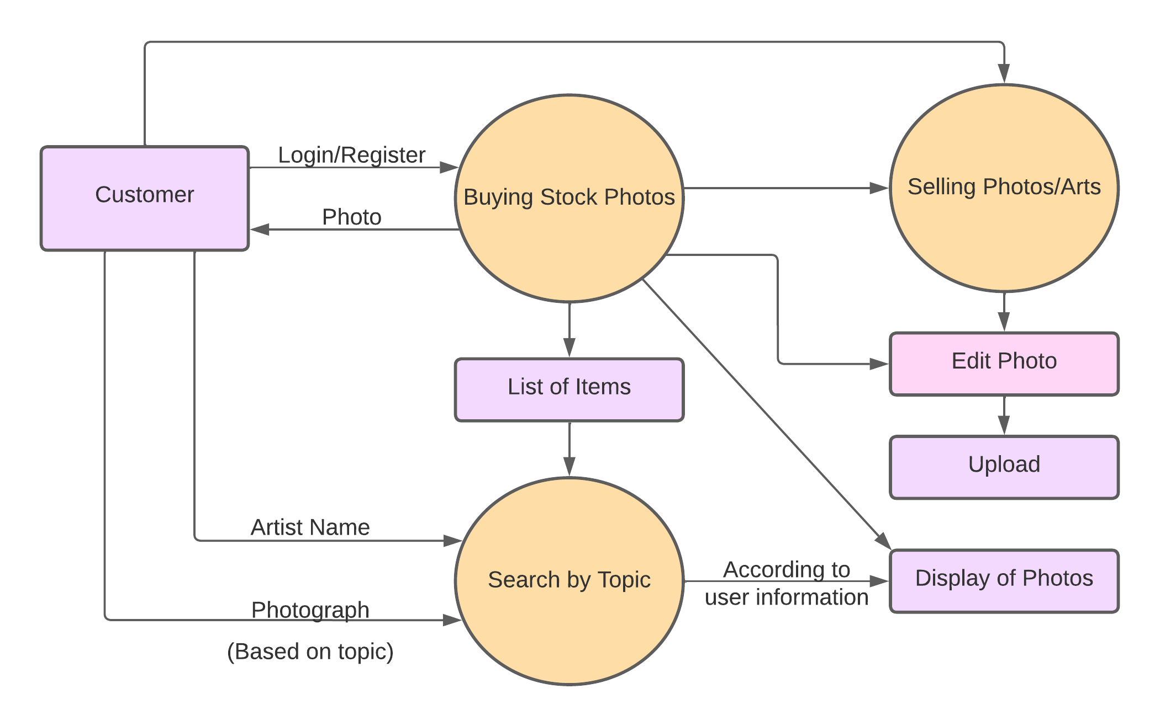
Fig. 8.2 DFD level 2

Slide 13

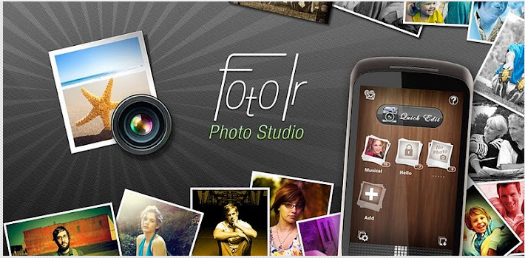
9. Features
Access to variety of high-quality photographs.
Innovative application flow.
Worry-free licensing and legal protection.
Online image editing.

Slide 14




10. Technology Stack
Frontend/Language: HTML, CSS
Backend/Database: MySQL
Additional Tool: Bootstrap
Operating System: Windows

Slide 15
11. Suggestion in Review-1
For PPT
  Change Use case diagram.
  Add Dataflow diagram.
  Remove links from references.
In Project
  Validation with email.
  Add Terms and Conditions.

Slide 16
12. Result and Discussion
The PhotoStock offers photos, illustrations, vectors, and many others for download by businesses, marketing agencies, and media organizations.
PhotoStock helps creative professionals from all backgrounds and businesses of all sizes produce their best work with incredible content and innovative tools, all on one platform. It also helps creators to explore themselves with similar minds on the platform and help them grow and encourage to perceive there hobby.

Slide 17



13. Future Scope
Deploying database on cloud
Enhancing the Edit option
Provide subscription to users
Upgrading the project design and workflow

Slide 18
Reference
[1] Online Studio Management System, IRJET journal publish paper, March 3, 2019
[2] Responsive Home page from Mr web designer YouTube channel, January 2, 2022
[3] Upload Page from Easy tutorial YouTube channel, July 19, 2022
[4] Digital photography by Eric Meyer, Research paper, February 15, 2022
[5] ICT in Business by Dr. R. Karuppasamy and Mr. C. Arul Venkadesh, June 15, 2018

Slide 19
Thank You...!!

